Slide 1
Information Systems and Data Modeling
IT1090

Slide 2
Contact Person
Lecturer In Charge:
Ms. Manori Gamage
Lecturers:
  Ms. Pradeepa Bandara
  Ms. Thamali Kelegama
  Ms. Tharushi Rubasinghe
Enrolment Key: IT1090

Slide 3
Learning Outcomes
Learning Outcome | Description
LO1 | Explain the importance and impact of information systems in business organizations.
LO2 | Evaluate the information systems strategies to achieve organizational goals.
LO3 | Model data requirements using data models.
LO4 | Apply formal methods to refine the data model.
LO5 | Use SQL to store and modify the data in the database, and to write queries to satisfy real world application level problems.

Slide 4
Module Delivery
Lectures
  2 × 1 hours of lectures per week
Tutorials
  1 × 1 hour tutorial per week
Lab Sessions
  2 × 1 hours of lab session per week

Slide 5
Assessment Criteria
Assessment components | Contribution to the final grade | Learning outcomes covered
Continuous assessments
Mid-term Examination | 20% | LO1-LO3
Assignment | 20% | LO1-LO5
Final Examinations
Final Examination (individual) | 60% | LO1-LO5
Total | 100%

Slide 6
Primary References
Laudon, K.C and Laudon, J.P., Management Information Systems: Managing the Digital Firm, 13th ed., Pearson Prentice Hall
Ramakrishnan, R. and Gehrke, J., Database Management Systems, 3rd ed., McGraw-Hill
SQL Server 2016 Documentation
Elmasri, R. and Navathe, S.B., Fundamentals of Database Systems, 5th ed., Addison-Wesley.
Silberschatz A., Korth H.F. and Sudarchan S., Database Systems Concepts, 3rd ed., McGrawHill , 1996
Connolly and Begg, Database Systems: A Practical Approach to design, Implementation and management, 3rd ed., Addison-Wesley

Slide 7
Information systems in business organizations
Lecture – 01

Slide 8
Learning Outcome
LO1: Explain the importance and impact of information systems in business organizations.

Slide 9
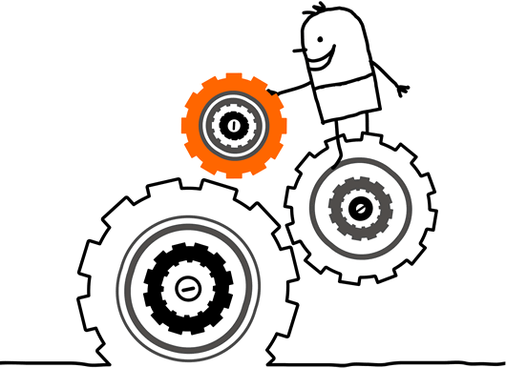
What is a System..?

Slide 10
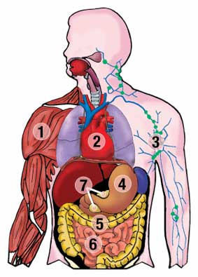
Example

Slide 11
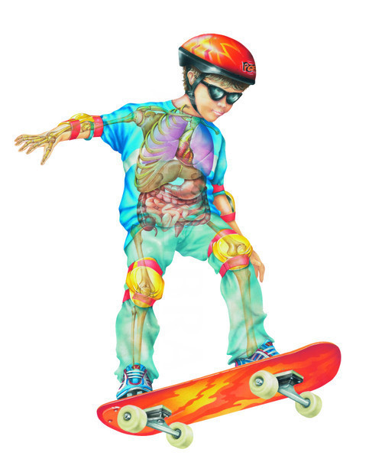
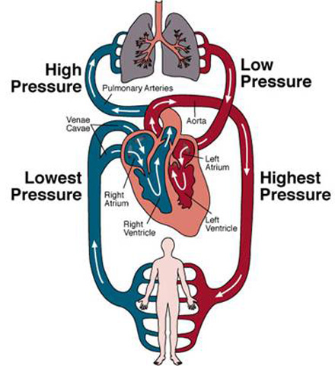
A System
An array of components that work together to achieve a goal or goals
components
work together
achieve a goal

Slide 12
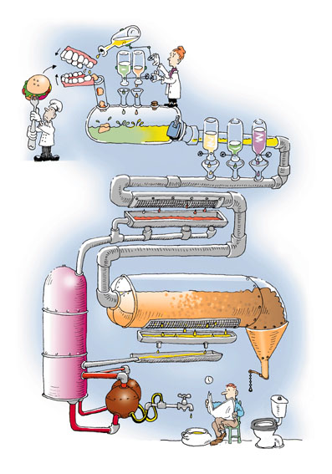

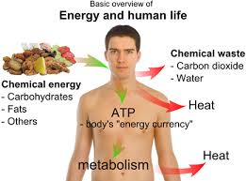
A System
Accepts input
Processes input
Produces output

Slide 13
A System
May have multiple goals
  E.g: Goals of the human body
    To Be Alive (Ultimate Goal)
    To Work
    To Survive
Contains Subsystems

Slide 14
What is a Subsystem..?

Slide 15
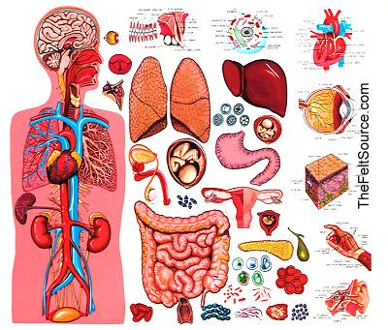

Slide 16
A Subsystem
Human Body
Respiratory System
Skeletal System
Muscular System
Digestive System
Nervous System
is a component of a system, it can also be considered a system in its own right.
have sub-goals that meet the main goal
transfer output to other subsystems

Slide 17
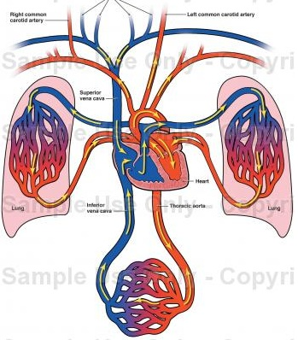
Subsystems Transfer Output to Other Subsystems

Slide 18

What is an Information System..?

Slide 19
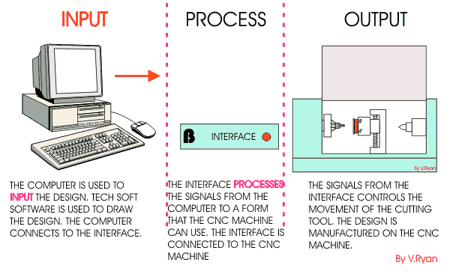
An Information System
is a collection of components that work together to provide information to help in the operations and management of an organization.

Slide 20
Information Systems
An Information System collects, processes, stores, analyzes, and disseminates information for a specific purpose
Information System is an arrangement of people, data, processes, information presentation, and IT that interact to support and improve day-to-day operations in an organization (As well as support the problem solving and decision making needs of various people)
An Information System is not necessarily be computerized

Slide 21
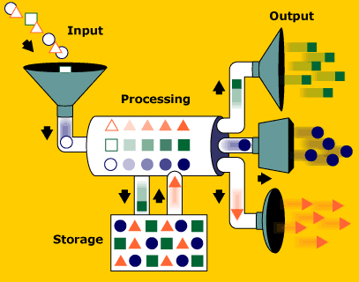
Components of an Information System

Slide 22
Components of an Information System
Hardware - Equipment such as computers
Software - Instructions for the equipment
Stored Data - Facts stored in the system
Personnel - People who operate the system
Procedures - for the user to follow

Slide 23
Examples of Information Systems
Library Information Systems
Banking systems
Inventory control systems
Billing systems
Hospital management systems
Hotel reservation systems
What are the information systems you know..?

Slide 24

E.g.: – SLIIT Library Information System

Slide 25
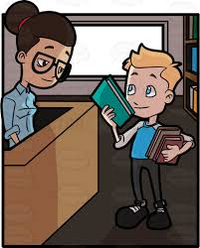
E.g.: – SLIIT Library Information System
Let’s look at the library information system at SLIIT which provides the facility to borrow books for studies
Borrowing involves; students and staff registering to the system, selecting the desired material from the library and library assistant recoding it against the studentID

Slide 26

E.g.: – SLIIT Library Information System
What information does this system provide?
  Periodically the system reports on the books available, books overdue, membership
  Calculates fines for overdue books
  Check for valid membership

Slide 27
E.g.: – SLIIT Library Information System
How does this information helps?
  This helps the Librarian to decide whether to understand the needs of the membership (add new books), track the borrowings and over dues, easy communication with membership

Slide 28
Functions of an Information System

Slide 29
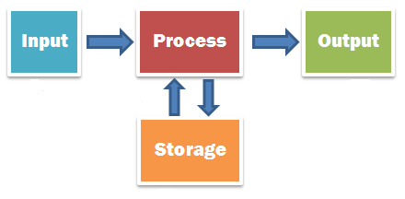
Functions of an Information System
An Information System accepts facts or data from outside the system, stores and processes the facts, and produces the results for use outside the system

Slide 30
Functions of an Information System
Input Function accepts the input data from outside the system.
Storage Function retains input data and retrieves stored data.
Processing Function calculates and in other ways manipulates the input and stored data.
Output Function produces results of processing for use outside the system.

Slide 31
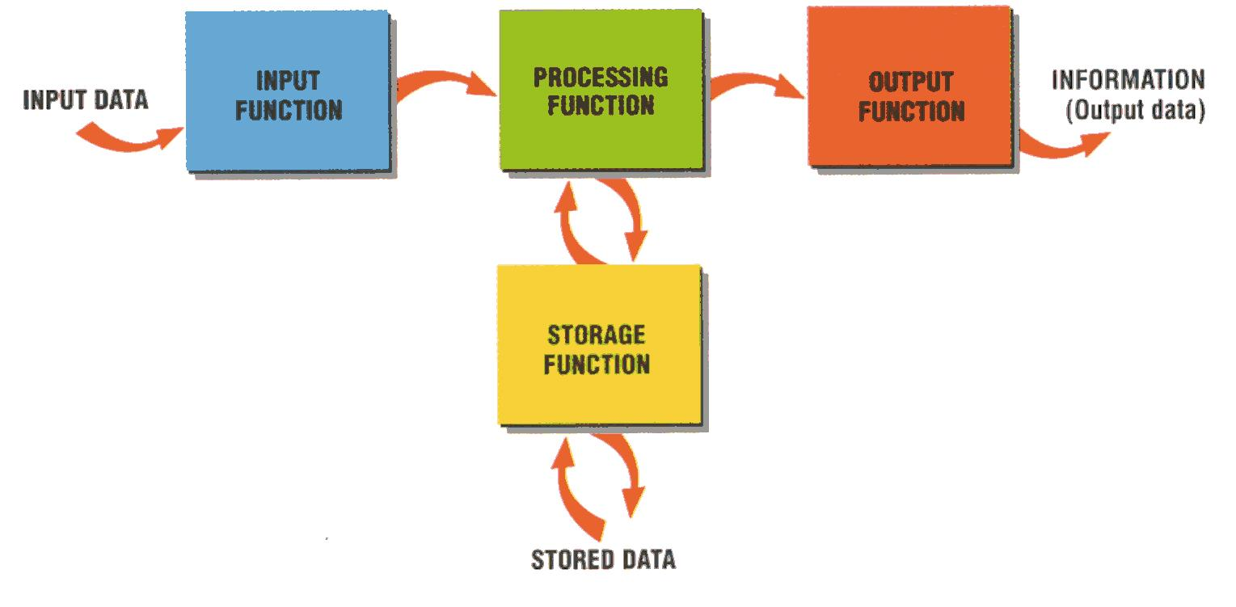
Functions of an Information System

Slide 32
Characteristics of Useful Information
Not all information is useful
Useful information should be:
  Relevant
  Complete
  Accurate
  Current
  Obtained economically (in business)

Slide 33

Information Systems Users

Slide 34

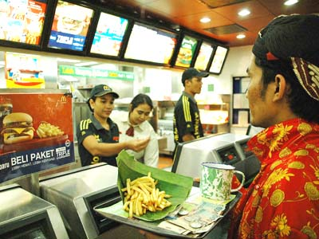
Information System Users
An information system user is a non-computer oriented person who gains some benefit from using an information system in his or her personal or work life
Sometimes called as an end-user, to distinguish from computer professionals

Slide 35
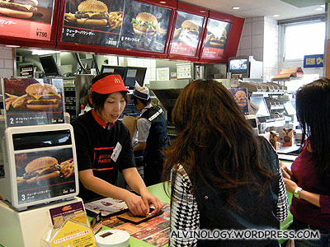
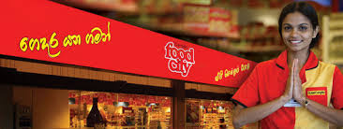
Information System Users
When you go to a fast food restaurant and buy a hamburger, the counter person is the user of the retail food system
When you go to a retail goods store and buy some
essential items, the cashier is the user of
the point of sales system

Slide 36
Types of Information Systems Users
Direct Users - Users may use an information system directly by pressing keys on a computer keyboard or by operating a piece of equipment that sends input data to a computer
  Eg.: A person using spreadsheet software to do financial projections
In-direct Users - A user may use an information system indirectly by having someone else enter the data and receive the output which is then given to the user
  Eg.: A sales manager who receives periodic, printed sales reports

Slide 37
Any information system you know..??

Slide 38

Are Systems Unique..?
Some systems are unique to a particular industry;
Eg.: Health care industry
  Patient-scheduling systems
  Nursing allocation systems
  Pharmaceutical systems

Slide 39
Are Systems general…?
Some systems are general enough for the use in a variety of industries;
  Inventory
  Payroll
  Billing
  Invoice Processing
  Human Resource Management
  Personal Productivity software

Slide 40

The Categorization of Information Systems
So, we need a way to categorize Information Systems…there are many ways;
  By number of people whose work is affected by the system
  By organizational structure
  By major functions
  By support provided

Slide 41
Types of Information Systems
Personal Information Systems
Workgroup Information Systems
Organizational Information Systems
Inter-organizational Information systems
Global Information systems

Slide 42
Benefits of Information Systems
Better information
Improved service
Increased productivity
Competitive Advantage

Slide 43
How organizations use IS Today
Information systems transform business
  Increase in wireless technology use, Websites
  Increased business use of Web technologies
  Cloud computing, mobile digital platform allow more distributed work, decision-making, and collaboration
Globalization opportunities
  Internet has drastically reduced costs of operating on global scale
  Presents both challenges and opportunities

Slide 44
How organizations use IS Today
In the emerging, fully digital firm
  Significant business relationships are digitally enabled and mediated
  Core business processes are accomplished through digital networks
  Key corporate assets are managed digitally
Digital firms offer greater flexibility in organization and management
  Time shifting, space shifting

Slide 45
How organizations use IS Today
Growing interdependence between ability to use information technology and ability to implement corporate strategies and achieve corporate goals.

Slide 46
How organizations use IS Today
Business firms invest heavily in information systems to achieve six strategic business objectives:
  Operational excellence
  New products, services, and business models
  Customer and supplier intimacy
  Improved decision making
  Competitive advantage
  Survival

Slide 47
Operational excellence
Improvement of efficiency to attain higher profitability
Information systems, technology an important tool in achieving greater efficiency and productivity

Slide 48
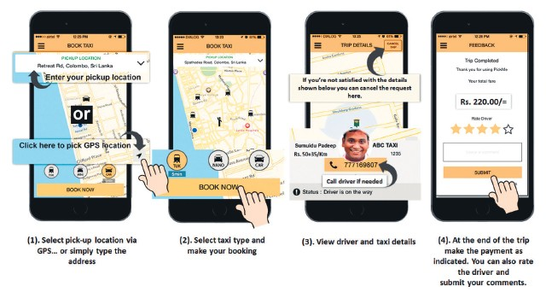
Operational excellence
E.g.:
  PickMe’s vehicle reservation system connecting driver and traveler based on location based services (GPS).

Slide 49
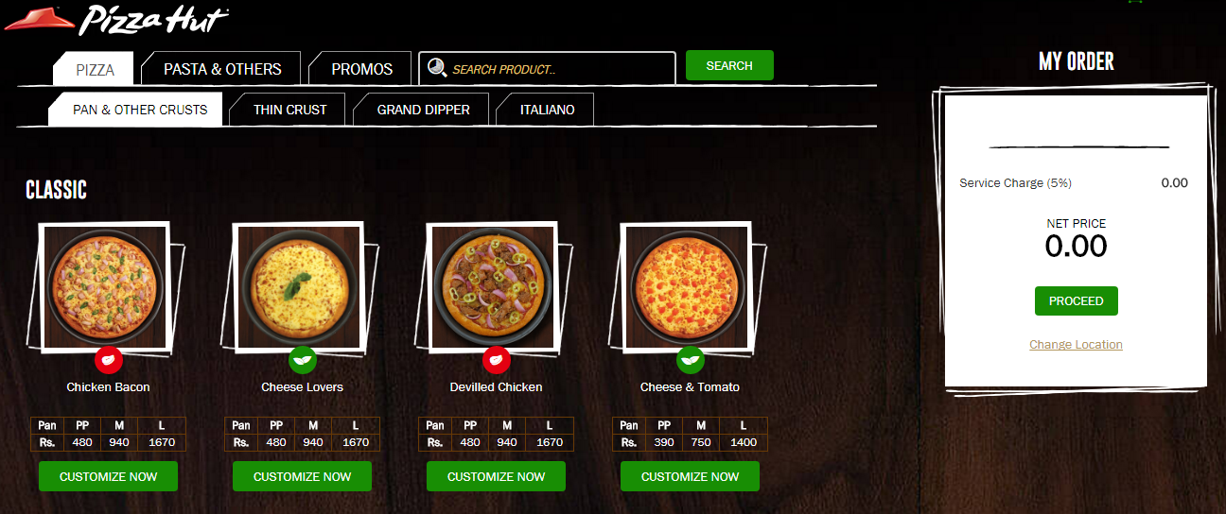
Operational excellence
E.g.:
  Pizzahut’s ordering system providing an interactive menu for customers to place an order.

Slide 50
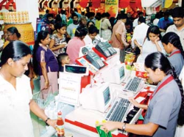
Operational excellence
E.g.:
  Cargill’s Foodcity’s point of sales (POS) system allows the counter person to calculate payments.

Slide 51
New products, services, and business models
Business model: describes how company produces, delivers, and sells product or service to create wealth
Information systems and technology a major enabling tool for new products, services, business models

Slide 52
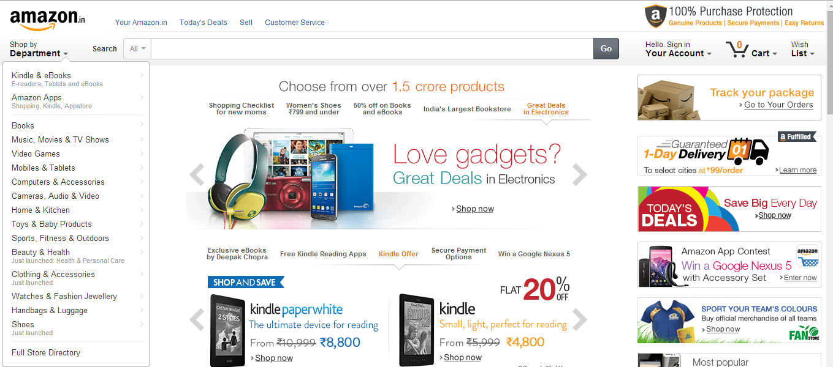
New products, services, and business models
E.g.:
Online business model of Amazon.com

Slide 53
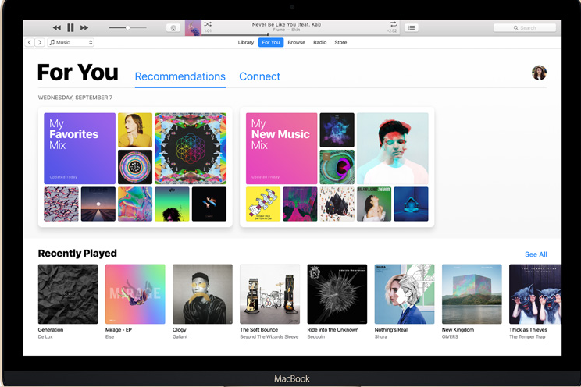
New products, services, and business models
E.g.:
Apple’s iTunes

Slide 54
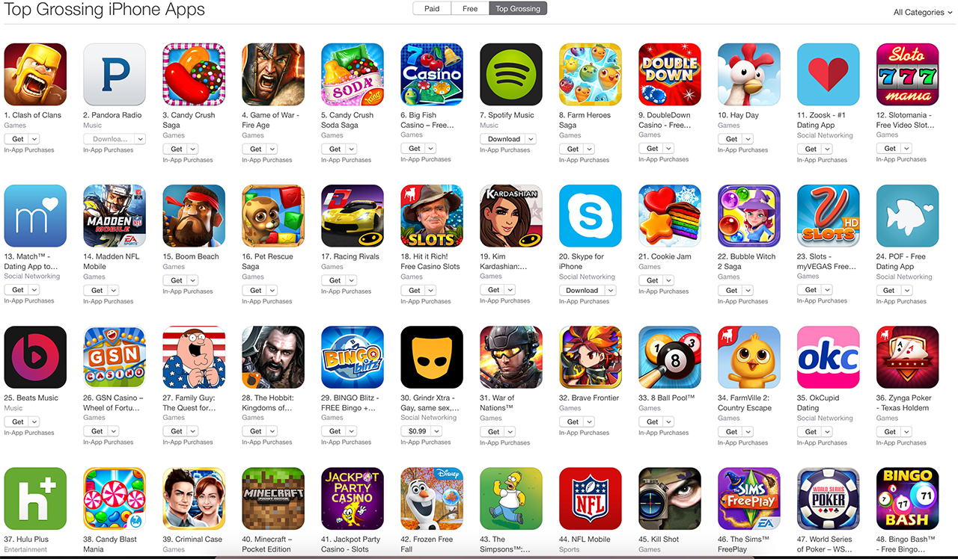
New products, services, and business models
E.g.:
Google’s apps store for mobile applications

Slide 55
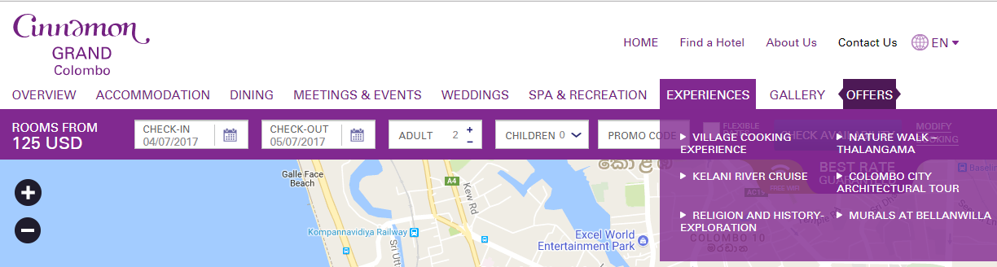
Customer and supplier intimacy
Serving customers well leads to customers returning, which raises revenues and profits
E.g.:
  High-end hotels that use computers to track customer preferences and use to monitor and customize environment

Slide 56
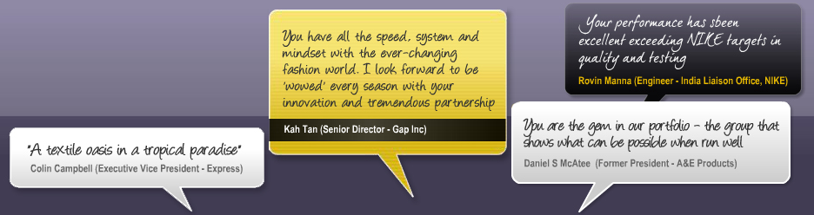
Customer and supplier intimacy
Intimacy with suppliers allows them to provide vital inputs, which lowers costs
E.g.:
  Brandix’s information system which links supplier to contract manufacturer

Slide 57
Improved decision making
Without accurate information:
  Managers must use forecasts, best guesses, luck
  Leads to:
    Overproduction, underproduction of goods and services
    Misallocation of resources
    Poor response times
  Poor outcomes raise costs, lose customers

Slide 58
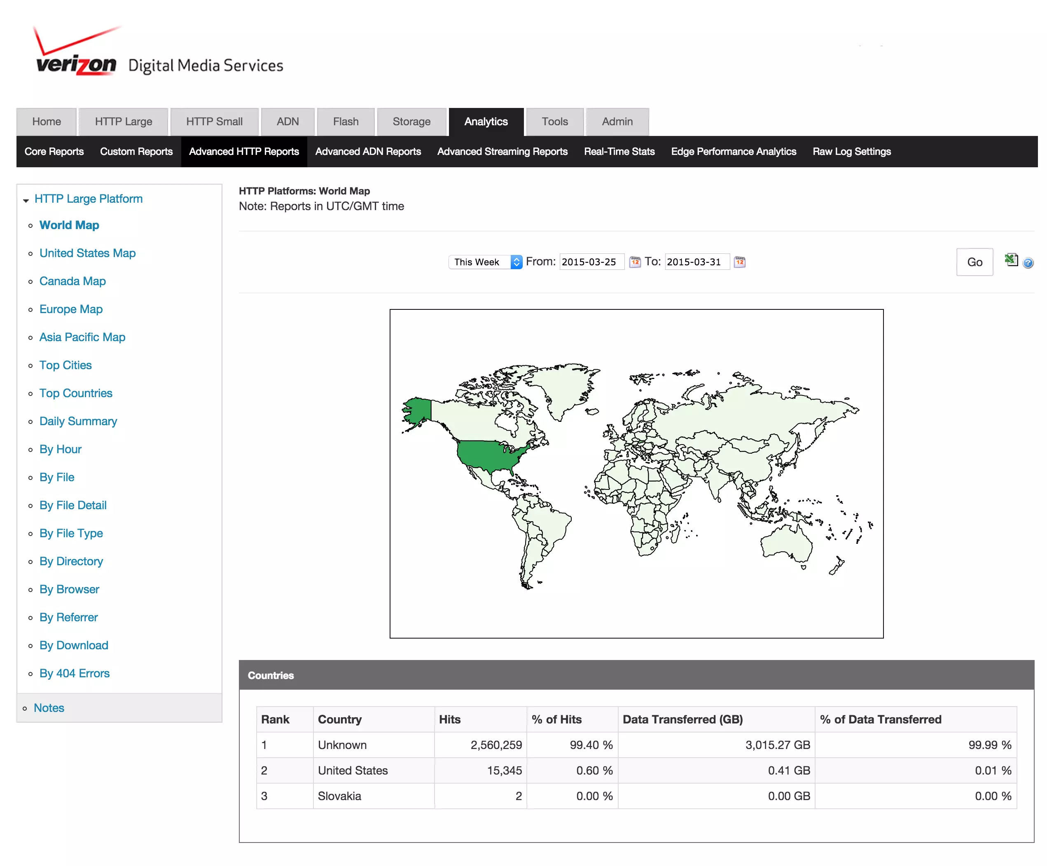
Improved decision making
E.g.:
  Verizon’s Web-based digital dashboard to provide managers with real-time data on customer complaints, network performance, line outages

Slide 59
Competitive advantage
Delivering better performance
Charging less for superior products
Responding to customers and suppliers in real time

Slide 60
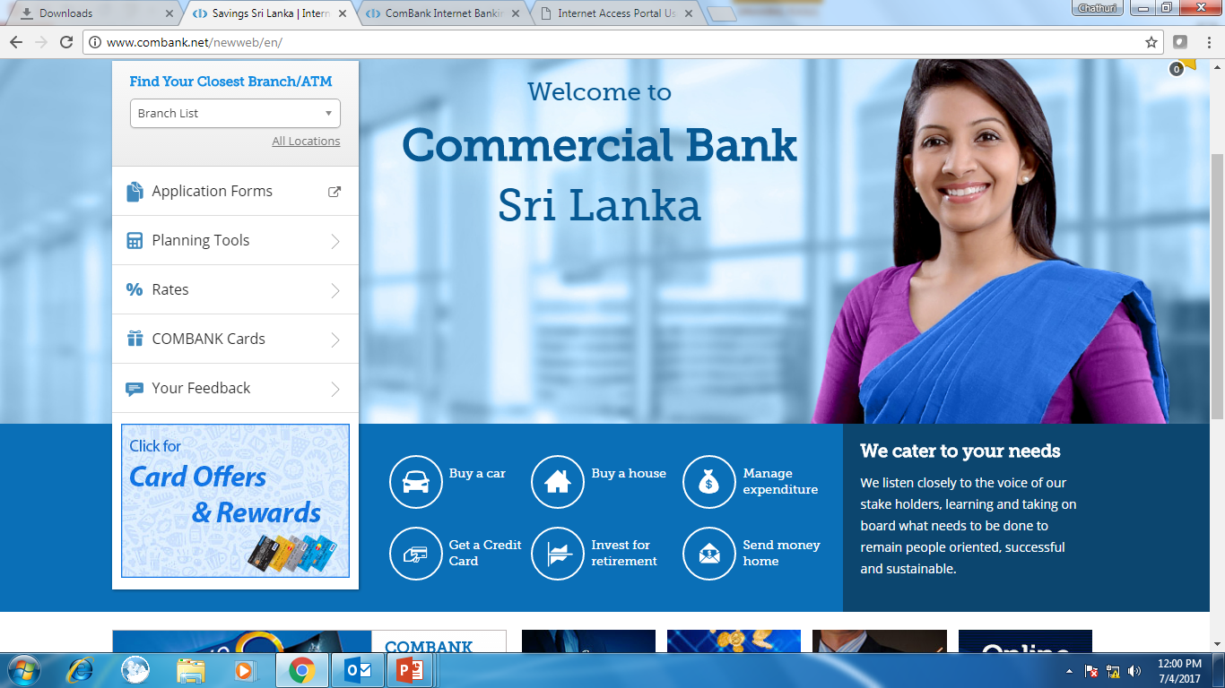
Competitive advantage
E.g.:
Online banking for customers

Slide 61
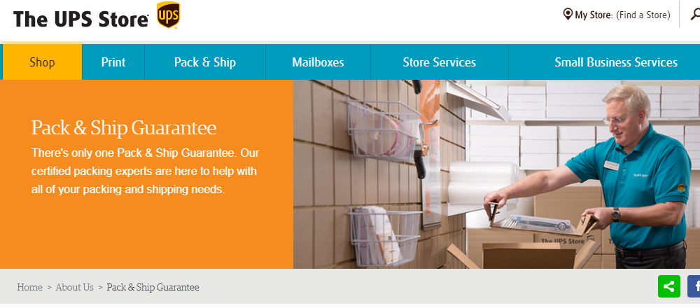
Competitive advantage
E.g.:
UPS online product tracking system for shipping and delivery

Slide 62
Survival
Some industries are heavily dependent on technology
Hence all businesses in the industry need to maintain the basic technologies used in the industry

Slide 63
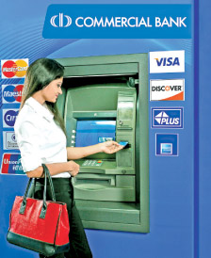
Survival
E.g.:
ATM systems for banks

Slide 64

End of Lecture - 01
Questions..?

Slide 65

Reference
K. C. Laudon and J.P. Laudon, “Management Information Systems: Managing the digital Firm”, Chapter 1, INFORMATION SYSTEMS IN BUSINESS TODAY, 13th Ed, 2014

Slide 66
Next Lecture
Gaining competitive advantage using information systems

